Slide 1
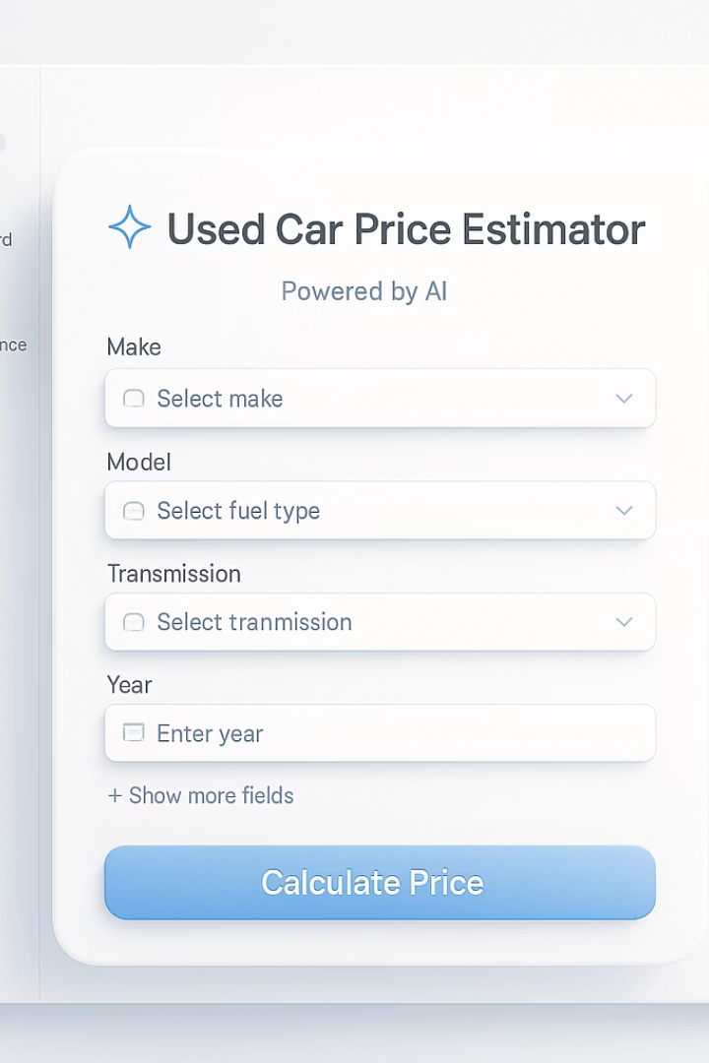

Predicting Used Car Prices with ML
A strategic approach to revolutionising trade-in valuations through machine learning
by Yuri Rocha Braga

Slide 2
Project Overview
Predictive tool for trade-in valuations
Stacked ML Ensemble
Instant pricing decisions in under 5 seconds
RF + HGBR + RidgeCV with 76.5% accuracy
FastAPI + Streamlit Solution
Significant Business Impact
Developed through 11 Agile Scrum sprints
+€400k/month for 200-car dealership

Slide 3
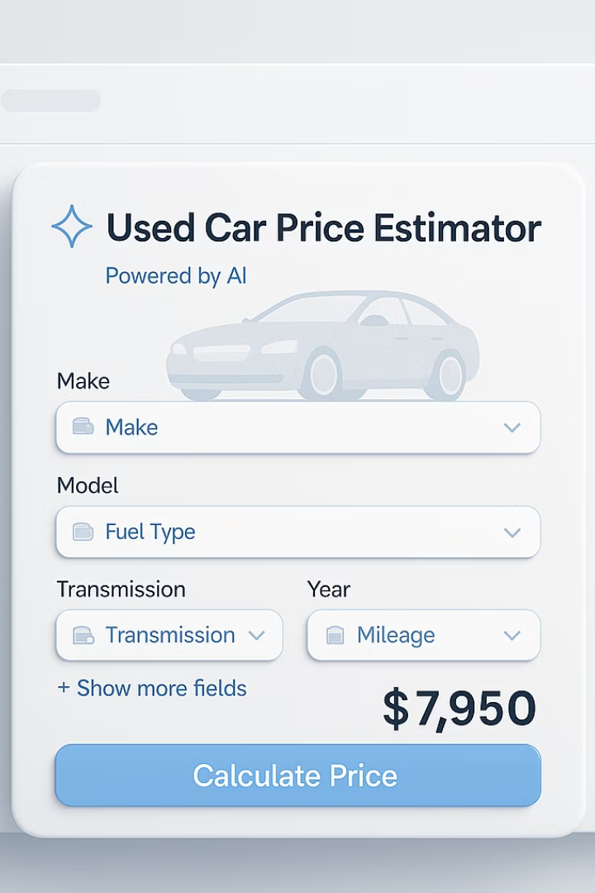




Strategic Problem & Goals
Manual pricing is slow and inconsistent
Current process lacks standardization
Promote sustainability
Extends car lifespans through accurate valuation
Market transparency
Data-driven appraisals build trust
Increased profitability
Maximize returns in growing market (+10% CAGR)

Slide 4
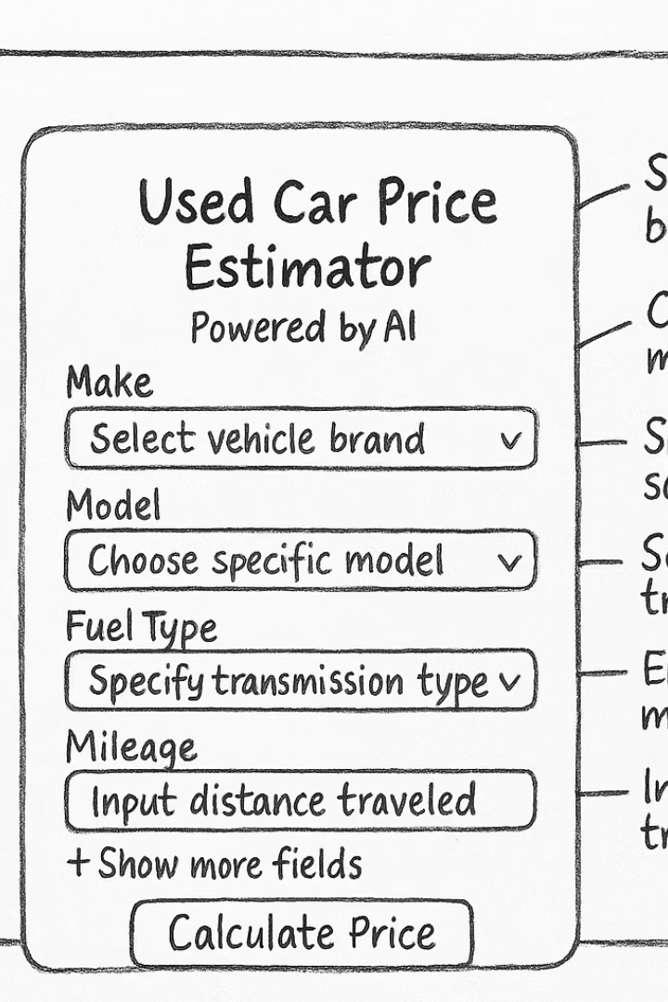



Project Plan - Agile Scrum
Sprints 1-5
Data pipeline & modeling
Sprints 6-8
Backend + UI development
Sprints 9-11
Deployment + testing
Tools: Notion (Kanban), GitHub, FastAPI, Streamlit

Slide 5
Business Understanding
Accurate Pricing
Instant Appraisals
Integration-Ready
Builds trust + increases conversion
Under 5 seconds per vehicle
CRM/SaaS compatible
Eliminates wait time
Scalable architecture
Data-driven decisions

Slide 6








SWOT Analysis
Strengths
Weaknesses
High-accuracy stack model, API-ready
20k sample limits edge-case generalization
Threats
Opportunities
Strong competition, evolving AI regulations
White-label SaaS tool, CRM integration

Slide 7








Methodology
Business Understanding
Data Preparation
Defining dealership needs
Feature engineering + cleaning
Deployment
Modeling
FastAPI + Streamlit implementation
Stacked ensemble approach

Slide 8
Data Exploration (EDA)
Price Distribution
Key Correlations
Feature Engineering
Right-skewed, removed outliers below €1000
Age (-0.62), mileage (-0.58) strongly affect price
Age, mileage/year, luxury brand flag

Slide 9
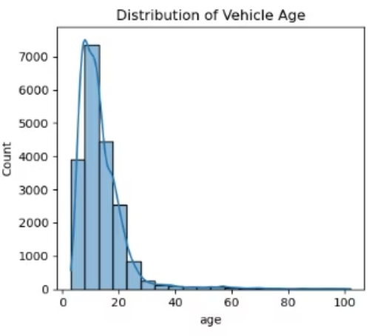
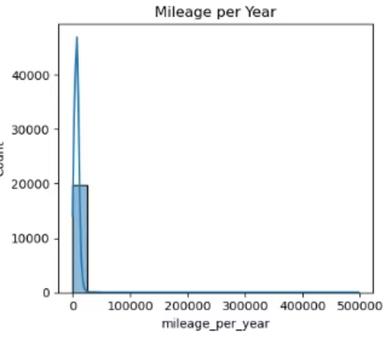
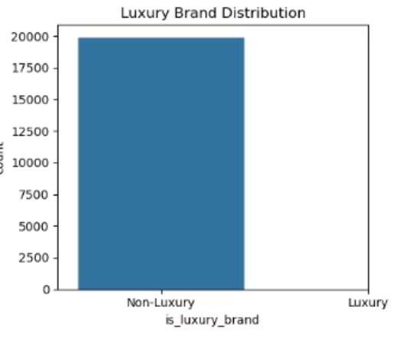
Exploratory Data Analysis: Key Feature Distributions

Slide 10
Engineered Features Overview
Vehicle Age (age)
Calculated from the difference between the current year and the vehicle's manufacturing year.
Captures depreciation effect — older cars tend to be cheaper.
Mileage per Year (mileage_per_year)
Derived by dividing total mileage by vehicle age.
Highlights vehicle usage intensity — useful for understanding wear and predicting maintenance needs.
Luxury Brand (is_luxury_brand)
Binary feature indicating whether the brand is classified as luxury.
Helps capture brand-driven pricing dynamics.

Slide 11
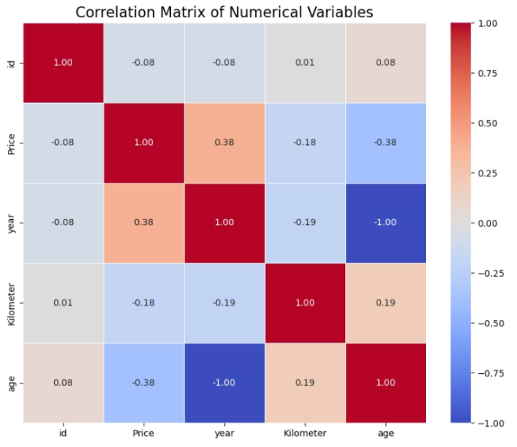
Correlation Matrix
Year vs Age (-1.00): Perfect negative correlation — newer cars are younger.
Age vs Price (-0.38): Older vehicles tend to have lower prices.
Year vs Price (0.38): Newer cars generally cost more.
Kilometre vs Price (-0.18): Slight negative correlation — higher mileage slightly reduces price.

Slide 12
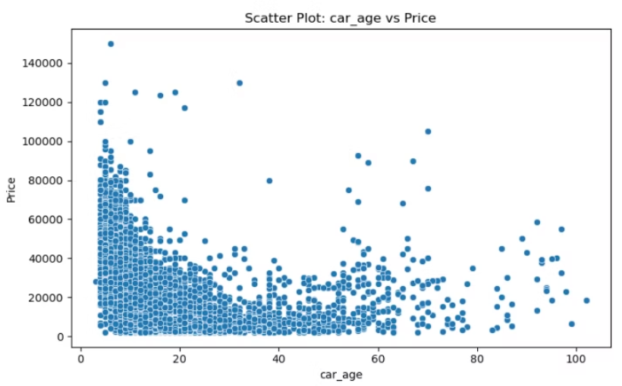
Scatter Plot: Car Age vs Price
Clear downward trend: As car age increases, price generally drops.
Steep decline in early years: New cars lose value quickly.
Price stabilizes: After ~20 years, prices flatten with some scattered outliers (e.g., collectibles or niche models).
Outliers: Some very old or young cars are priced unusually high — possibly luxury or classic cars.

Slide 13



Model Training
Random Forest
Robust baseline model
Histogram Gradient Boosting
Efficient, high accuracy
RidgeCV Meta-Learner
R²: 0.765, RMSE: 0.38

Slide 14
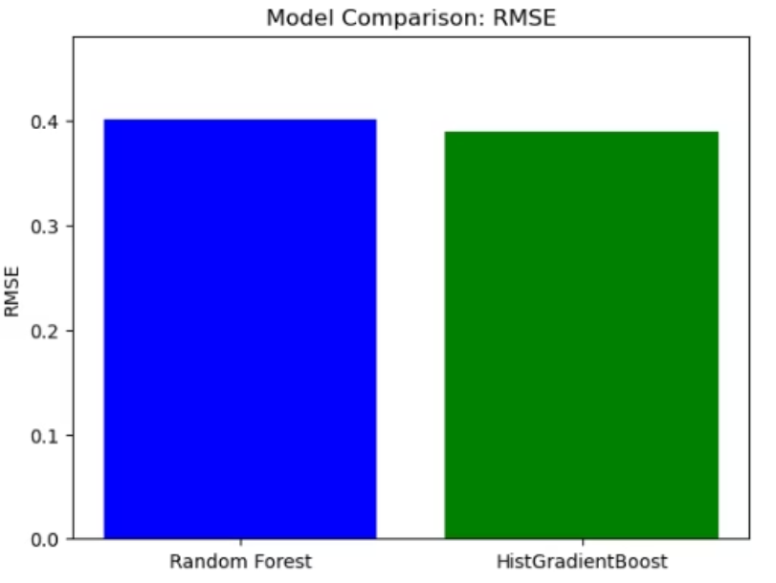
Model Comparison: RMSE
HistGradientBoosting performed slightly better with a lower RMSE (~0.38).
Random Forest RMSE was close, but marginally higher.
Best Hyperparameters:
Random Forest
n_estimators: 443
max_depth: None
min_samples_split: 9
min_samples_leaf: 2
HistGradientBoosting
learning_rate: 0.081
max_depth: 8
max_iter: 420
Test RMSE: 0.38 Test R²: 0.765 → Good predictive power.

Slide 15
Live vs. Predicted Price Comparison
Case
Vehicle
Predicted Price
Actual Price
Error (%)
1
Altima
$16,503.01
$16,634.00
0.8%
2
2018 BMW i3
$17,709.94
$16,995.00
4.2%
3
2017 Hyundai Tucson Eco
$11,559.95
$13,391.00
13.7%
Range of error: 0.8% (best) → 13.7% (worst)
Average error: ~6.2%kee
Key takeaway: In real-world listings, the tool hits within ±10% of market price most of the time—proof of concept for live trade-in scenarios.

Slide 16
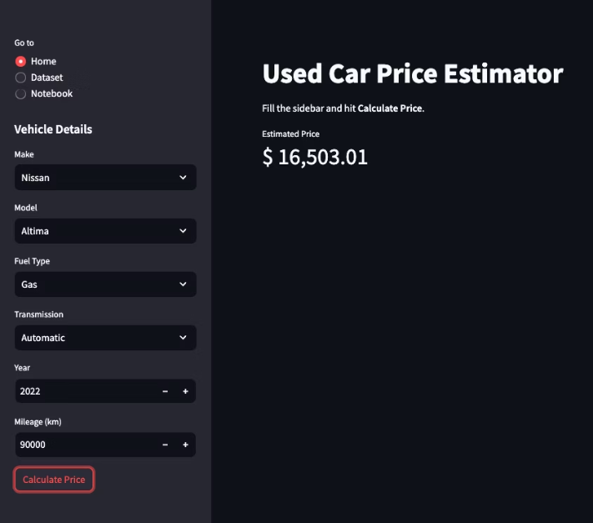
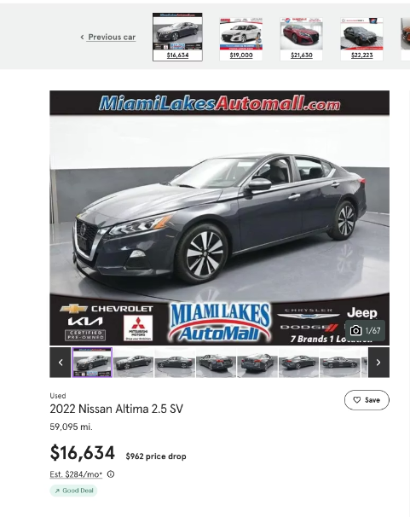
Prediction Accuracy: 99.2% of Actual Price (0.8% Error)

Slide 17
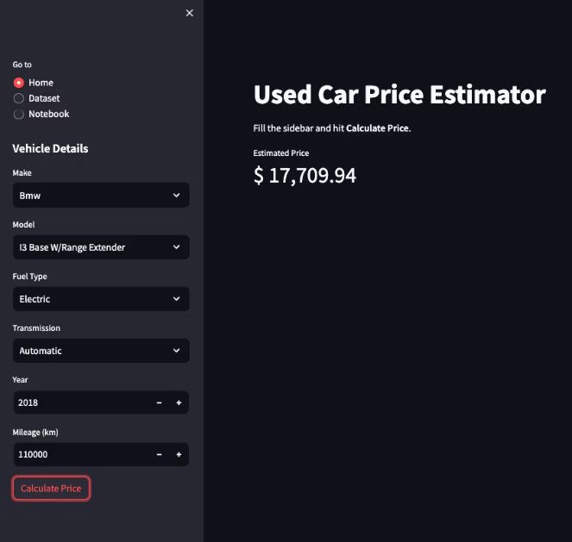
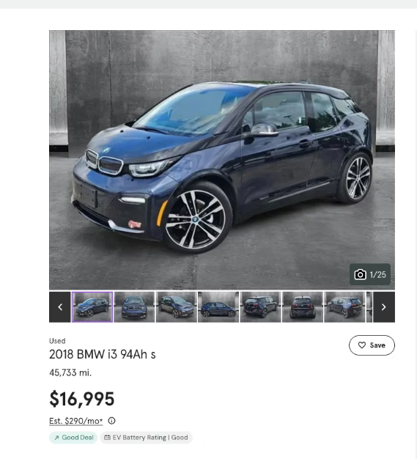
Prediction Accuracy: 95.79% of Actual Price (4.2% Error)

Slide 18
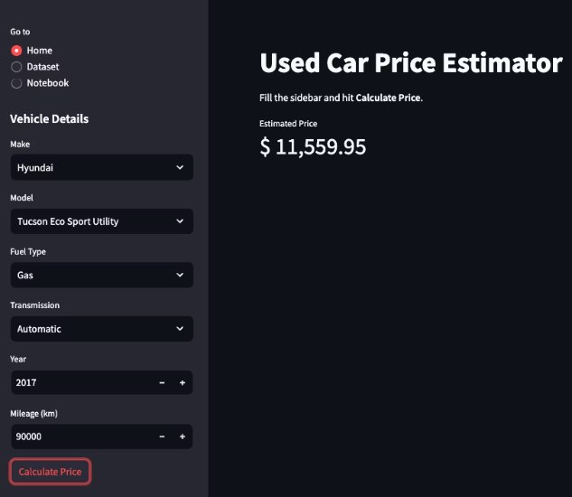
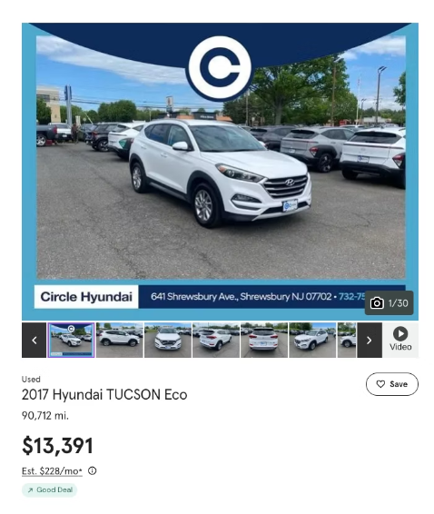
Prediction Accuracy: 86.3% of Actual Price (13.7% Error)

Slide 19
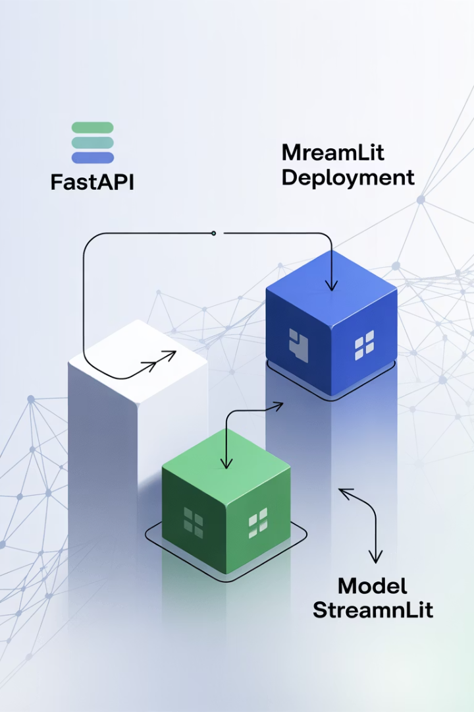




Deployment Architecture
ML Model
Serialized with joblib
FastAPI Backend
/predict endpoint serving results
Streamlit Frontend
User-friendly interface
Cloud Deployment
Scalable infrastructure

Slide 20
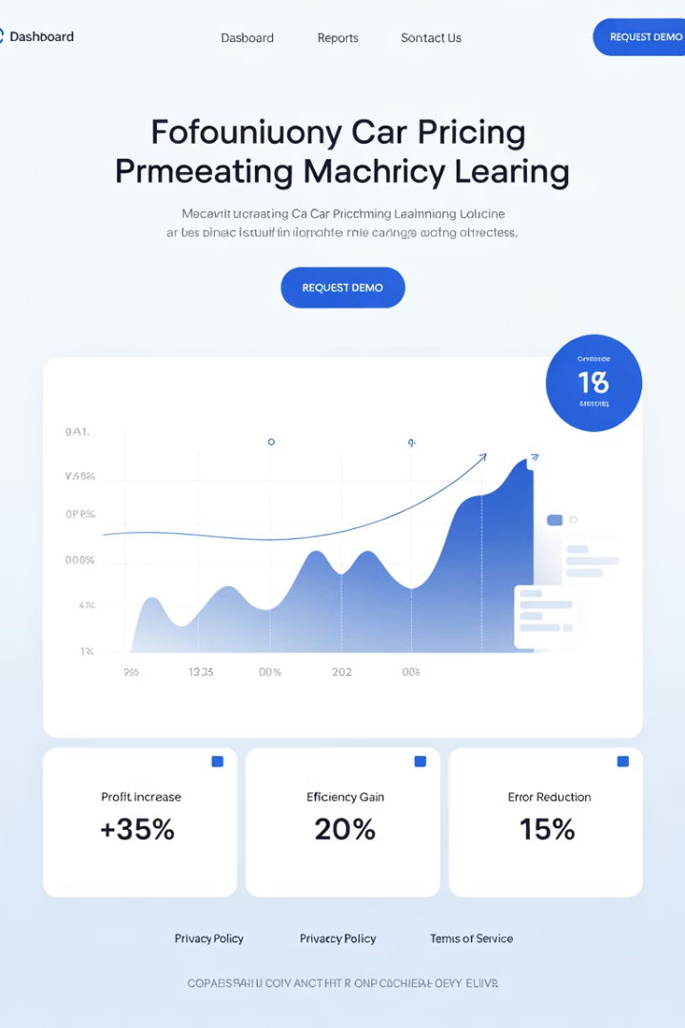
Results & Business Impact
<5sec
Appraisal Time
Down from 15 minutes
+20%
Conversion Rate
More completed sales
+40
Extra Deals
Additional monthly transactions
€400K
Monthly Profit
For 200-car dealership

Slide 21
Challenges & Future Plans
Current Trade-offs
Future Roadmap
Streamlit vs. web components
Web component version
Sample size limitation (20k rows)
Dataset expansion (100k+ rows)
Limited edge case handling
New features: condition, location
Regulatory compliance updates

Slide 22





Conclusion
Lightweight ML Tool
Tailored for dealership needs
Strong Performance
Fast integration, immediate ROI
SaaS-Ready
Customizable, scalable solution
Code Available
GitHub: bragayuri/strategic-thinking-ca-1

Slide 23
Thank You
Yuri Braga | sba24328 | Strategic Thinking | May 15th, 2025

